Slide 1
Integrating the
Access and Functional Needs Coordinator Role Into Your Emergency Operations Center

Slide 2
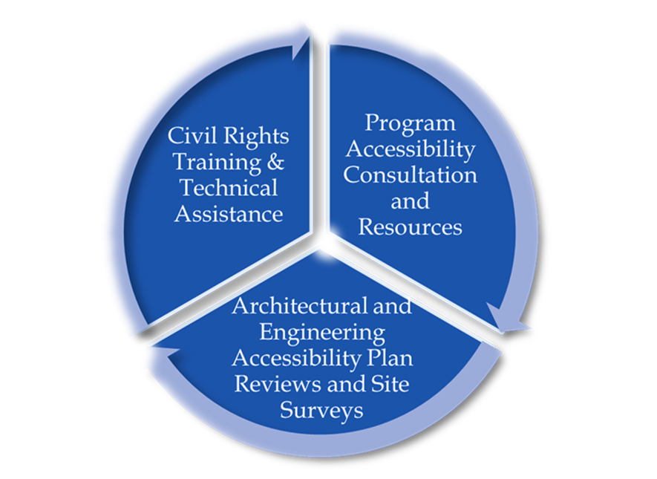
County of Marin
Disability Access Program
Laney C. Davidson, MPA
Disability Access Manager
ADA Coordinator, AFN Officer
(707) 333-4549
CA Relay 711
ldavidson@marincounty.org

Slide 3
Individuals with Access and Functional Needs (AFN)
Access and functional needs (AFN) refers to individuals who are or have:
Physical, developmental, mental health or intellectual disabilities
Chronic conditions or injuries
Limited English proficiency
Older adults
Children
Low income, homeless and houseless
Transportation disadvantaged (i.e., dependent on public transit)
Pregnant women

Slide 4
EOC Organizational Chart
 |  |  |  |  |  |  |  |  | EOC Director
 |  |  | EOC Coordinator |  |  |  |  |  |  |  |  |  |  | Public Information Officer
 |  |  |  |  |  |  |  |  |  |  |  |  |  |  |  |  |  | PIO Assistant
 |  |  | Safety and Security Officer |  |  |  |  |  |  |  |  |  |  | Liaison Officer
 |  |  | Legal Advisor |  |  |  |  |  |  |  |  |  |  | AFN Officer
 |  |  |  |  |  |  |  |  |  |  |  |  |  |  |  |  |  | AFN Assistant
 |  |  | Public Health Officer
 |  | Operations Coordinator |  |  |  |  |  |  | Plans & Intel Coordinator |  |  |  |  | Logistics Coordinator |  |  |  | Finance Coordinator

Slide 5
Incident Command Structure (ICS)
“The Incident Command System (ICS) is a standardized hierarchical structure that allows for a cooperative response by multiple agencies, both within and outside of government, to organize and coordinate response activities without compromising the decision-making authority of local command”. – Americorps.

Slide 6
Emergency Operations Plan
“Crucial to the emergency response system are emergency operations plans (EOP), which describe who will do what, as well as when, with what resources, and by what authority--before, during, and immediately after an emergency”. - FEMA

Slide 7
Building the Framework
Establish a positive working relationship with your:
  Office of Emergency Services
  Law Enforcement
  Fire Department
  Public Health Department
  Administrator/Managers Office
  Public Works Department
  IT Department
  Disability Community

Slide 8
Access and Functional Needs
Position
AFN Position within Management Section;
Position Description;
Checklists;
Integration of AFN Processes and Procedures into other Section Operations.

Slide 9
Access and Functional Needs
Position Description
Access and Functional Needs (AFN) - The Access and Functional Needs advocate evaluates operations in the context of people with disabilities and Access and Functional Needs (AFN), ensures that they receive adequate attention in planning and communications functions, and ensures that language and disability program access and physical accessibility issues are addressed at all levels of emergency response.
*EOP currently being updated

Slide 10
Access and Functional Needs
Position; the Ideal Candidate
ADA Coordinator;
Organizational Employee or Community Partner with strong organizational knowledge;
Strong ties with other local jurisdictions and municipal agencies, the Disability Community and Community Based Disability Organizations;
Knowledge of Digital Accessibility Laws and Applications.

Slide 11
Participate in Tabletop Exercises and Planning Activities Before an Activation
Engage early and often!
Make AFN a household term!
Educate the AFN Community on preparation!

Slide 12
Examples of Activities During Activation I
Executing contracts and securing services (ASL, CDI, CART Captioning, etc.);
Linking CBO’s that serve individuals with disabilities with emergency response personnel;
Coordinating with PIO teams to ensure accessible communications;
Coordinating with HR and IT to ensure digital formats are accessible to employees with disabilities and the public;

Slide 13
Examples of Activities During Activation II
Coordinating with other Departments to ensure policies and procedures are accessible (ex. Parks, Sheriff’s Office);
Coordinating with food security initiatives;
Educating Call Centers on how to place and receive CA Relay calls;
Coordinate with Logistics to ensure all supplies procured are or include accessible options;

Slide 14
Examples of Activities During Activation III
Providing input on all planning, strategy, objective and action plan processes;
Surveying sites for accessibility (temporary housing, sheltering, temporary work sites, testing sites, etc.);
Coordinating with medical surge planners and identifying methods for obtaining DME and medications.

Slide 15
Much Work Still to be Done!
Policy and Procedure creation and changes;
Culture change still needed;
Infrastructure of the position to be built out;
Networking and trust building still needed;
Layering of additional disasters (PSPS, fires) will further complicate and delay.

Slide 16
Integrating the
Access and Functional Needs Coordinator Role Into Your Emergency Operations Center

